Slide 1
7.2.1
TRANSITION FROM OFFLINE TO ONLINE MODE:
ONLINE TEACHING LEARNING /ADMISSION/ADMINISTRATION

Slide 2
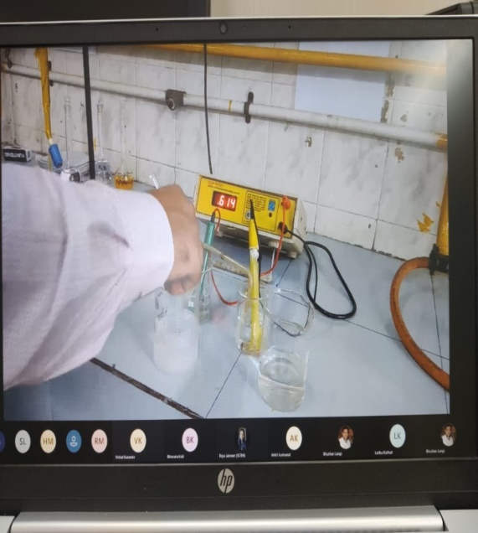
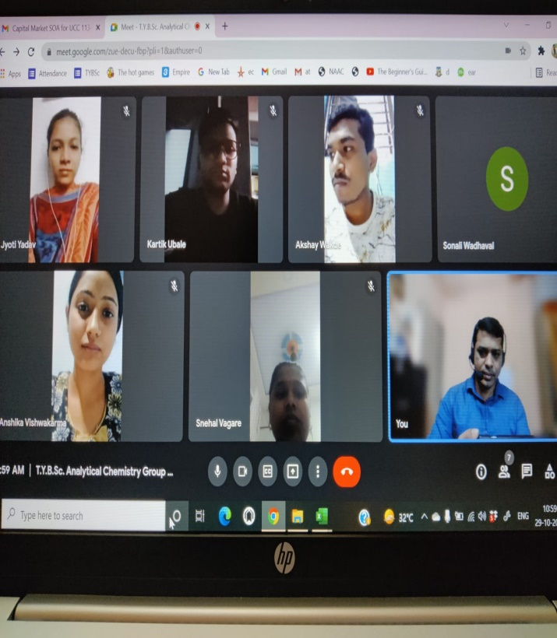
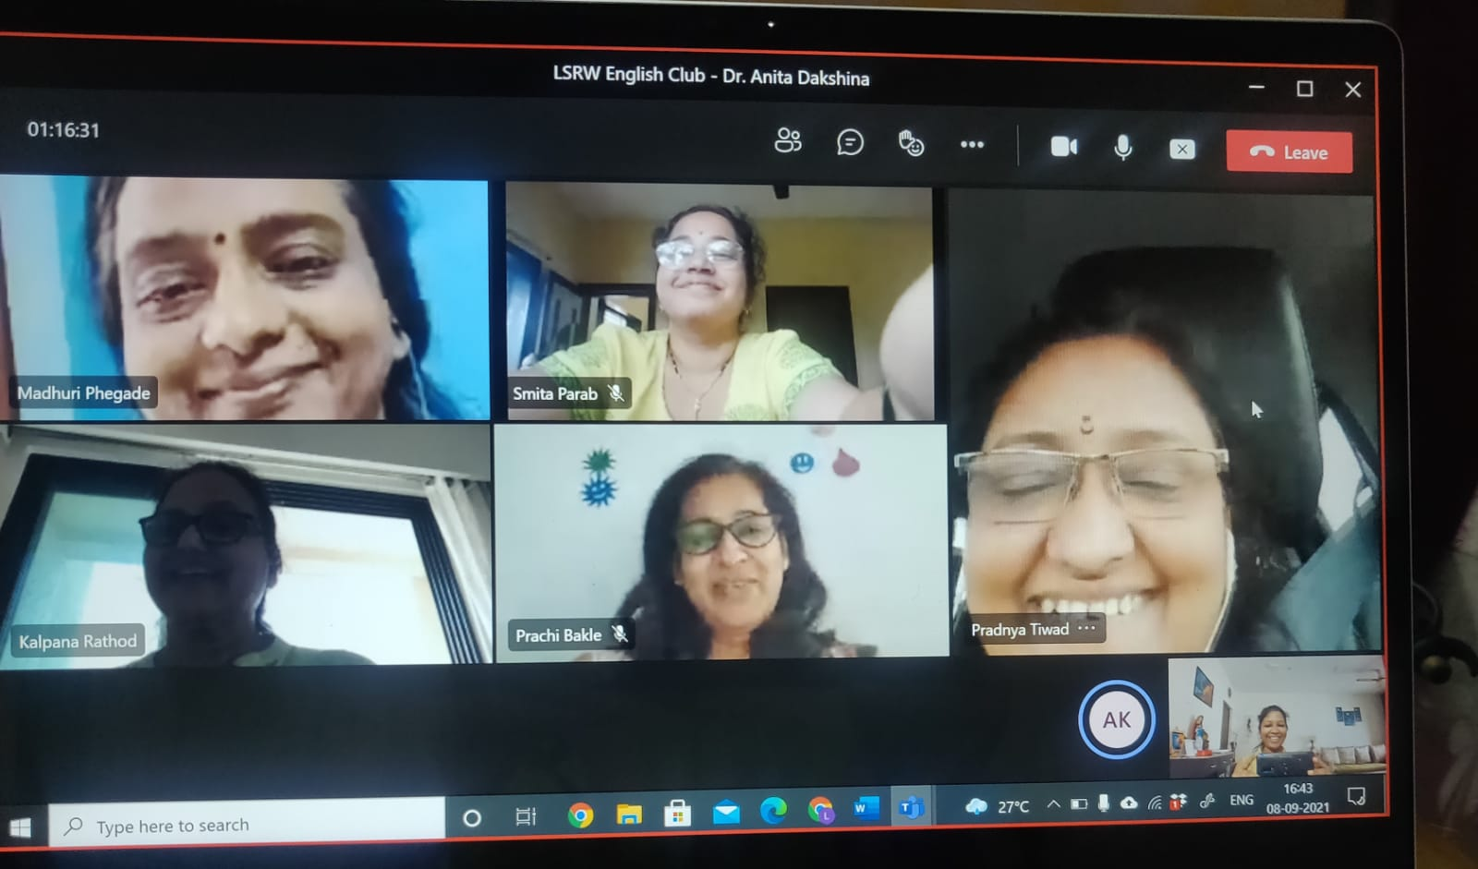
Online sessions

Slide 3
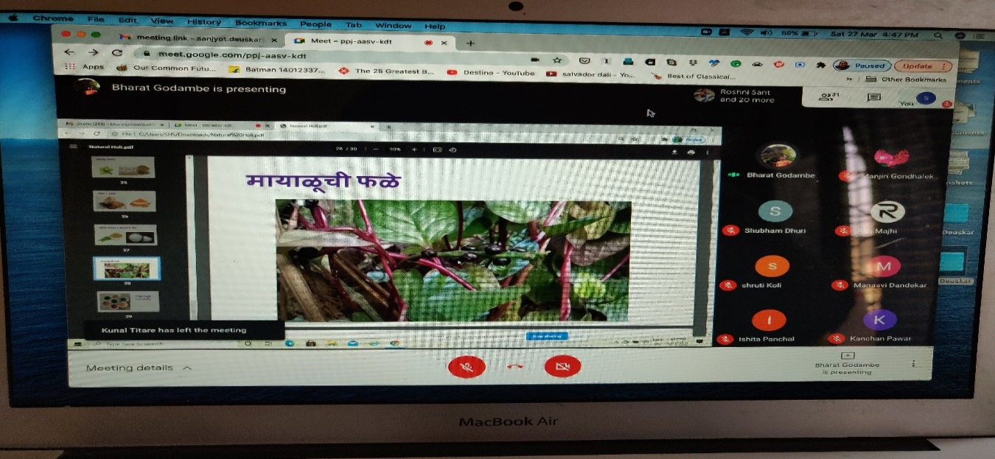
Online Webinars

Slide 4
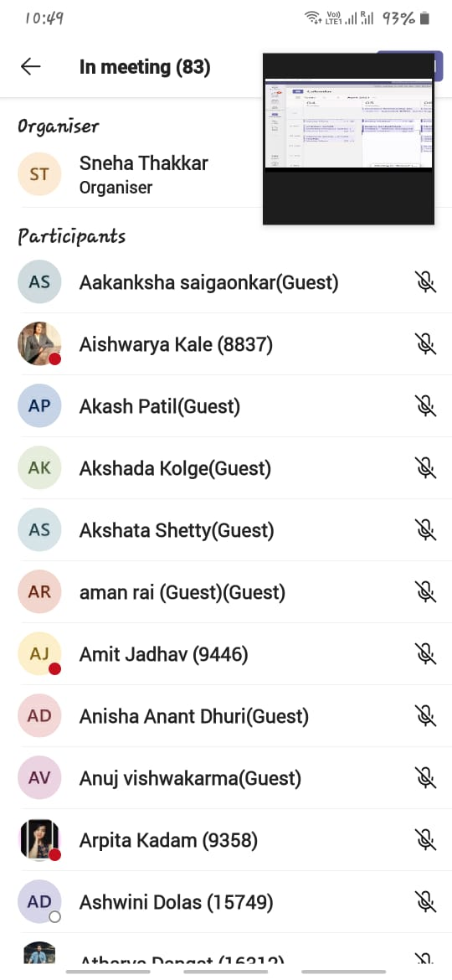
Attendance

Slide 5
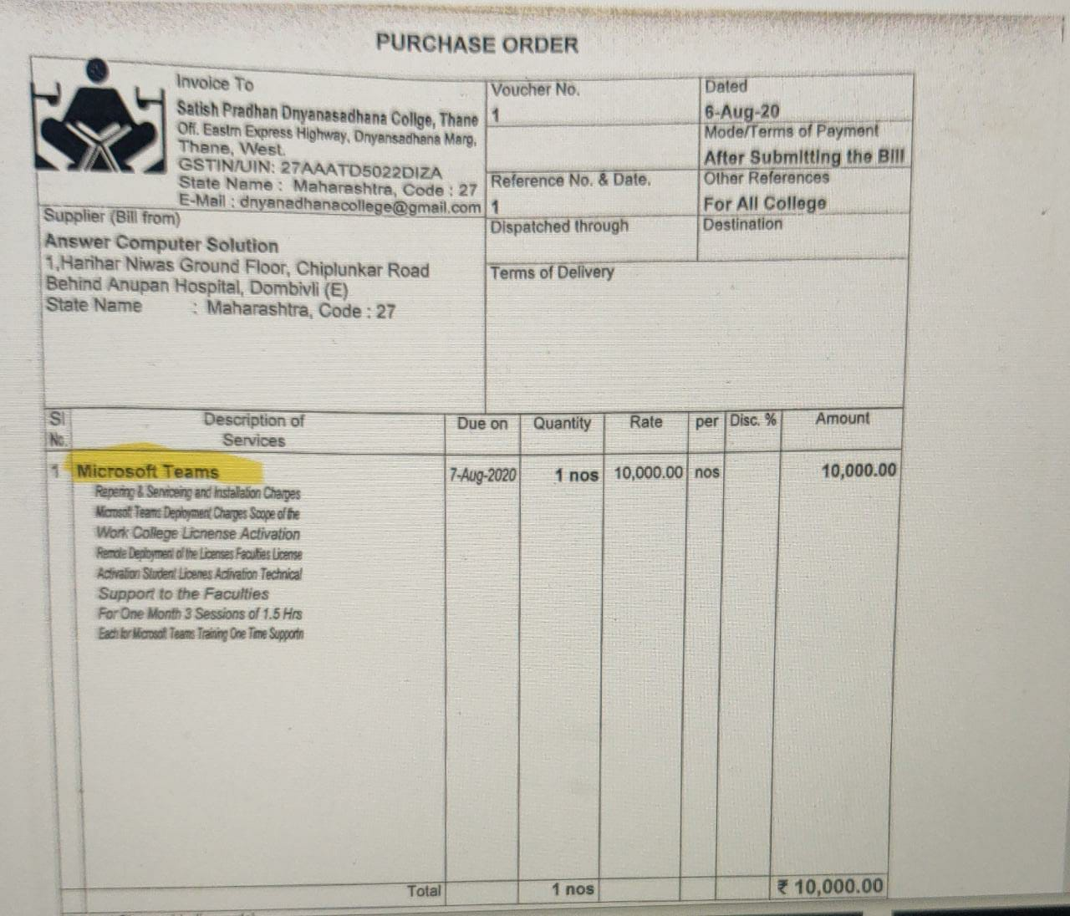
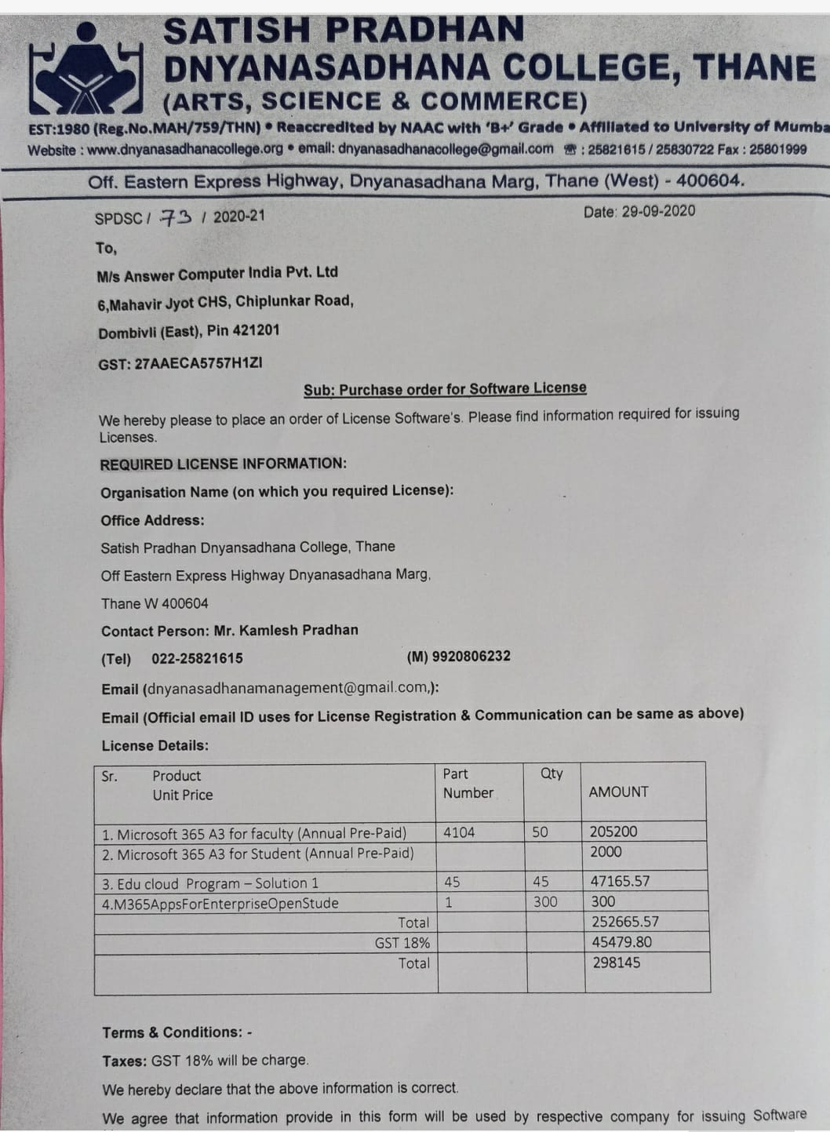
MS Teams For Online Teaching Learning

Slide 6
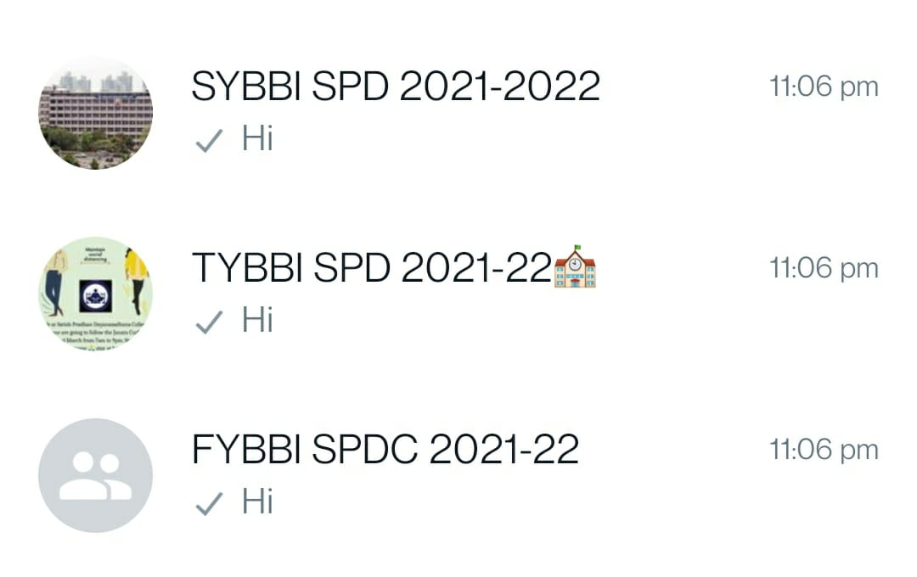
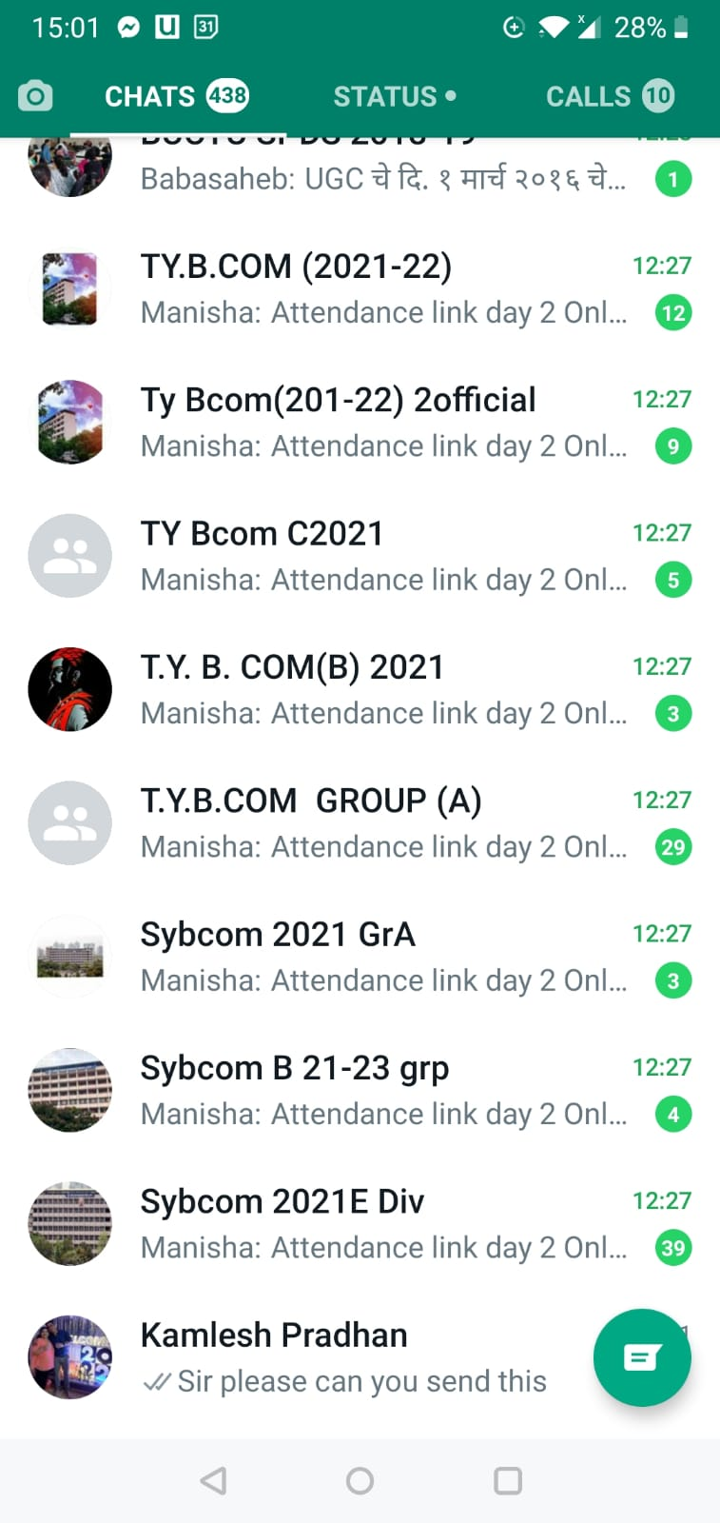
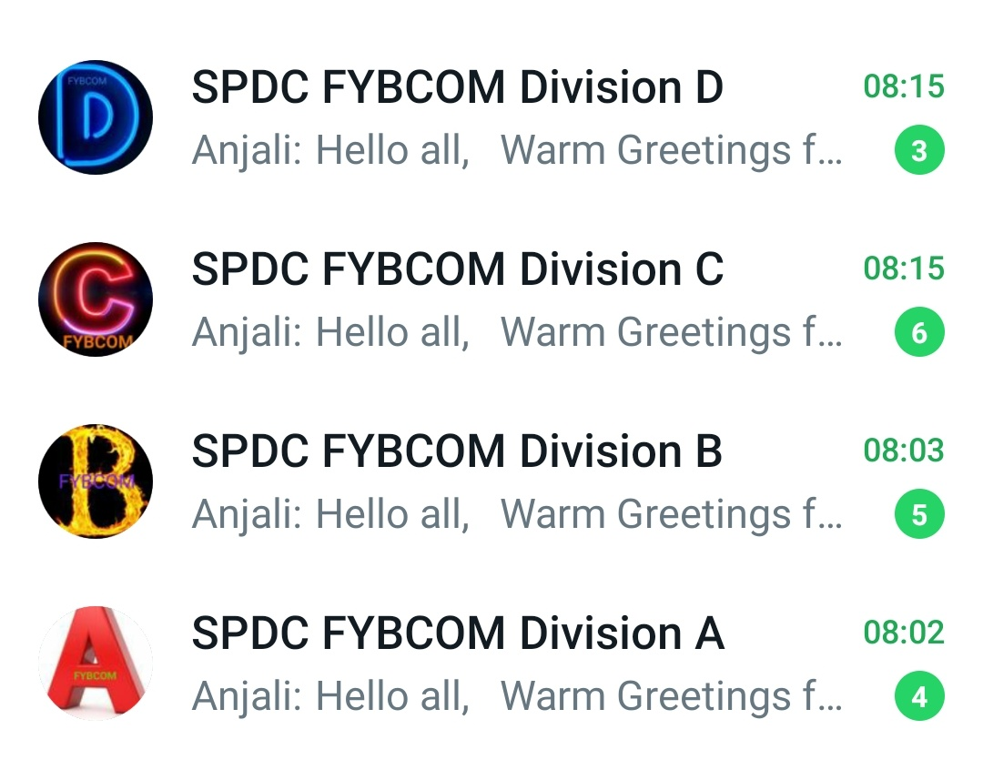
Whats App Group Of Different Classes To Post Time Table & Links

Slide 7
Distinct Official Email ID for All The Teaching And Non-teaching Staff

Slide 8
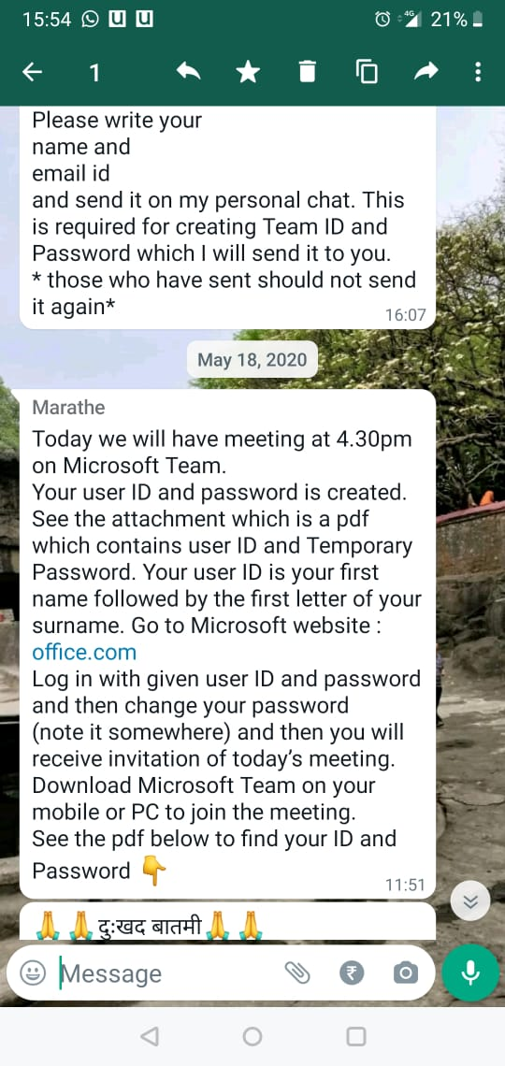
Evidences Of Training Of MS Teams

Slide 9
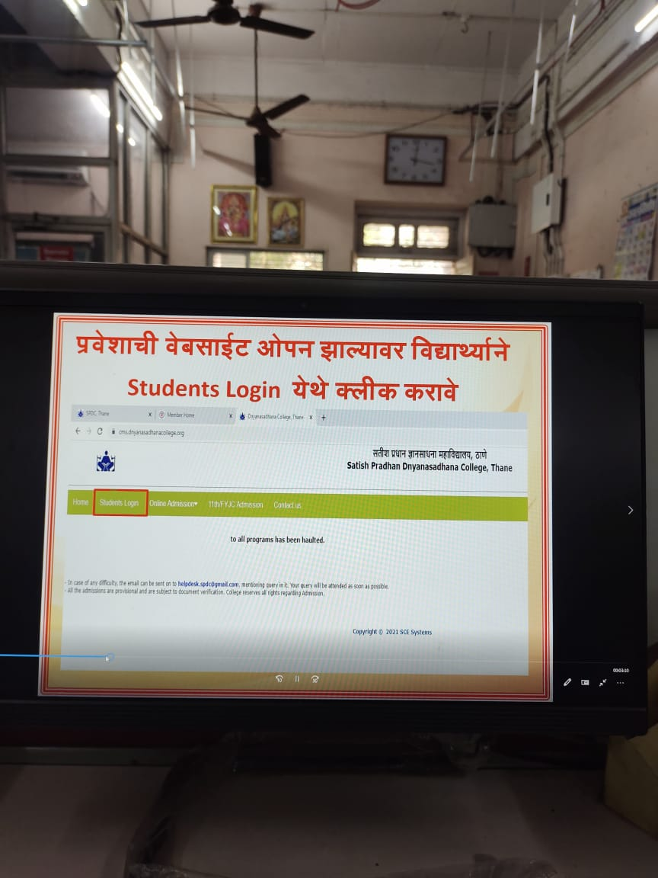
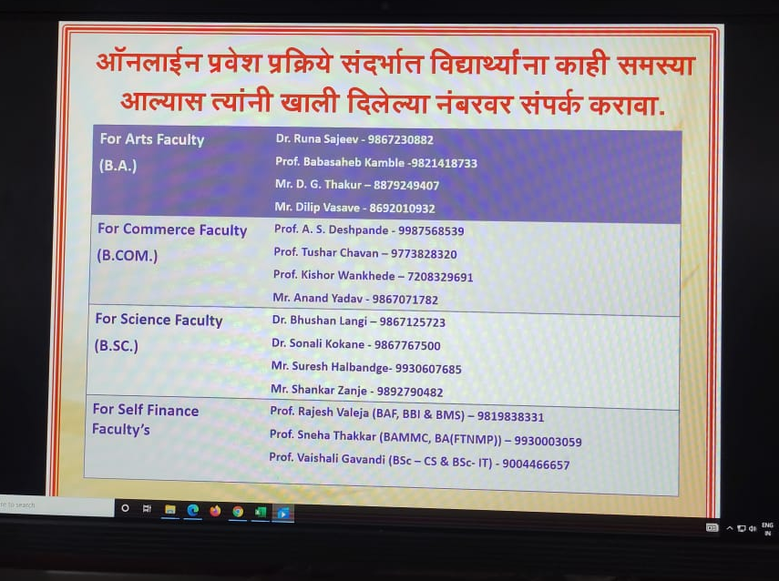
Explanatory Videos (English & Marathi) for assistance in Admission Process

Slide 10
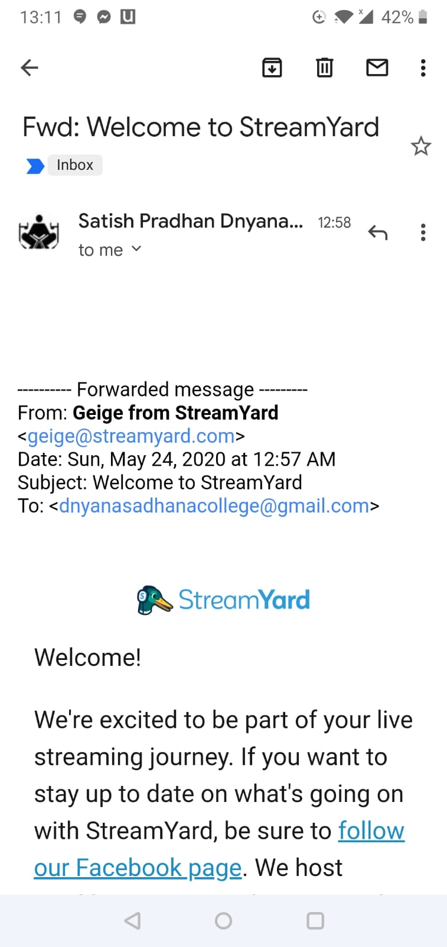
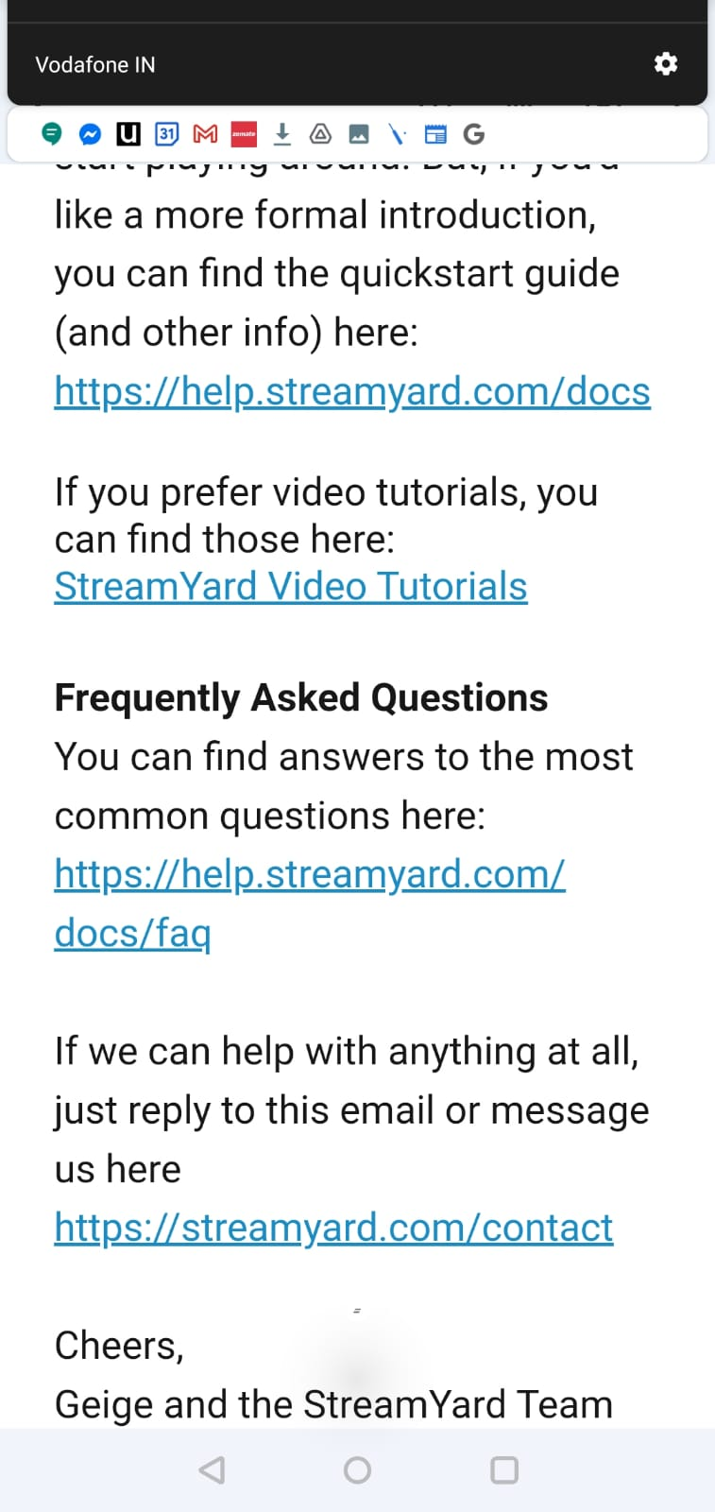
Stream Yard Training And Subscription

Slide 11
Link Created Subject Wise By The Teachers

